Slide 1
Multidimensional Data
-Ashu Mehta
Database Systems

Slide 2
Multidimensional data model
A multidimensional model views data in the form of a data-cube.
A data cube enables data to be modeled and viewed in multiple dimensions.
It is defined by dimensions and facts.
The dimensions are the perspectives or entities concerning which an organization keeps records.

Slide 3
Example
For example, a shop may create a sales data warehouse to keep records of the store's sales for the dimension time, item, and location.
These dimensions allow to keep track of things, for example, monthly sales of items and the locations at which the items were sold.
Each dimension has a table related to it, called a dimensional table, which describes the dimension further.
For example, a dimensional table for an item may contain the attributes item_name, brand, and type.

Slide 4
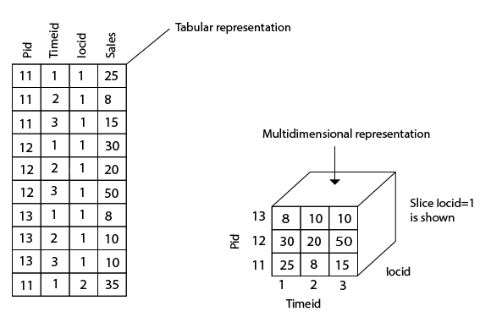

Slide 5
Example
Consider the data of a shop for items sold per quarter in the city of Delhi.
The data is shown in the table.
In this 2D representation, the sales for Delhi are shown for the time dimension (organized in quarters) and the item dimension (classified according to the types of an item sold).
The fact or measure displayed in rupee_sold (in thousands).

Slide 6
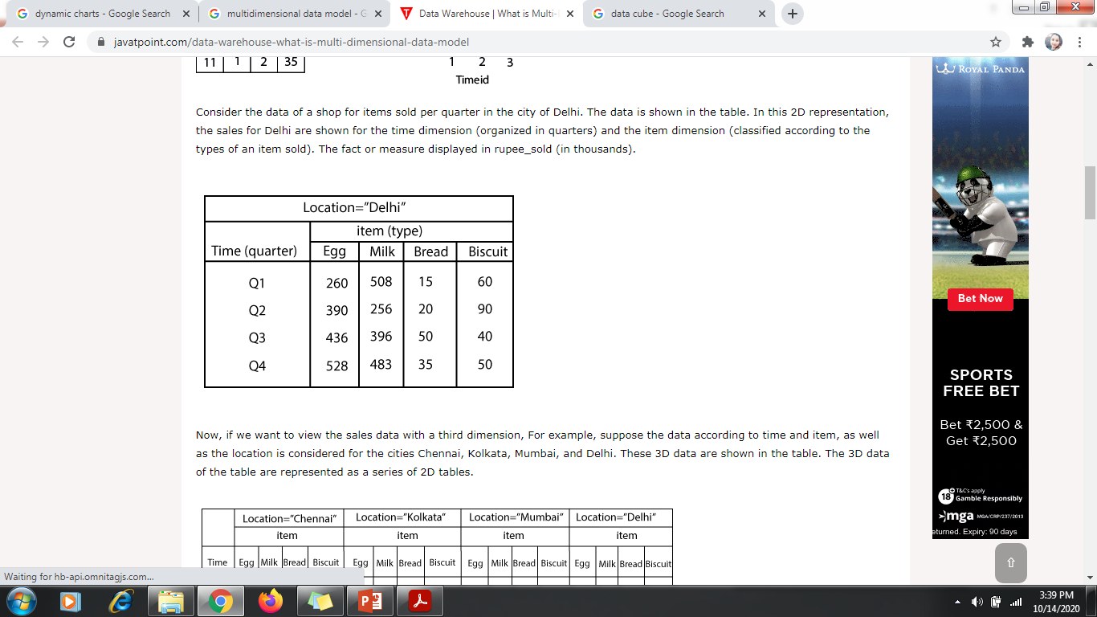
2D Representation of data

Slide 7
Now, if we want to view the sales data with a third dimension, For example, suppose the data according to time and item, as well as the location is considered for the cities Chennai, Kolkata, Mumbai, and Delhi.
These 3D data are shown in the table.
The 3D data of the table are represented as a series of 2D tables.

Slide 8
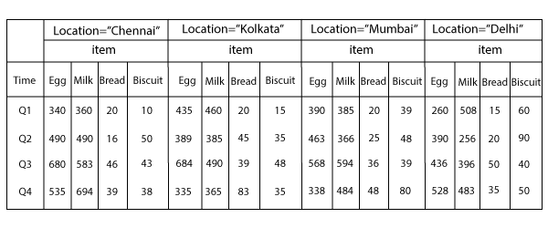
3D data as series of 2D data

Slide 9
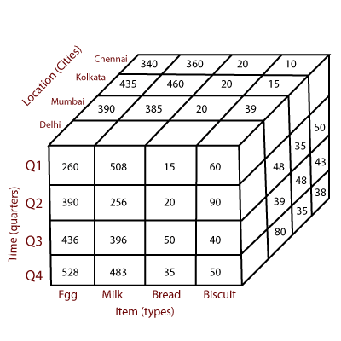
3D representation- Data Cube

Slide 10
OLTP vs OLAP
OLTP and OLAP: The two terms look similar but refer to different kinds of systems.
Online transaction processing (OLTP) captures, stores, and processes data from transactions in real time.
Online analytical processing (OLAP) uses complex queries to analyze aggregated historical data from OLTP systems.

Slide 11
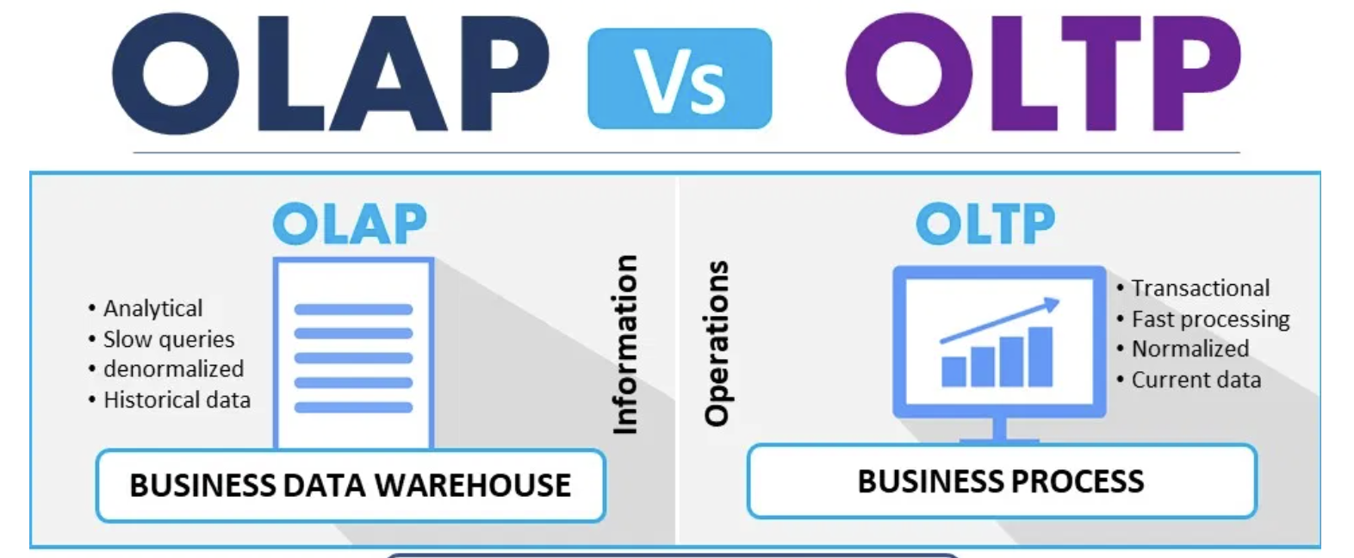

Slide 12
What is OLTP?
An OLTP system captures and maintains transaction data in a database.
Each transaction involves individual database records made up of multiple fields or columns.
Examples include banking and credit card activity or retail checkout scanning.
In OLTP, the emphasis is on fast processing, because OLTP databases are read, written, and updated frequently.
If a transaction fails, built-in system logic ensures data integrity.

Slide 13
Example of OLTP system
An example of OLTP system is ATM center. Assume that a couple has a joint account with a bank. One day both simultaneously reach different ATM centers at precisely the same time and want to withdraw total amount present in their bank account.

Slide 14
Other examples of OLTP system are:
Online banking
Online airline ticket booking
Sending a text message
Order entry
Add a book to shopping cart

Slide 15
What is OLAP?
OLAP applies complex queries to large amounts of historical data, aggregated from OLTP databases and other sources, for data mining, analytics, and business intelligence projects.
In OLAP, the emphasis is on response time to these complex queries.
Each query involves one or more columns of data aggregated from many rows.

Slide 16
Examples include year-over-year financial performance or marketing lead generation trends.
OLAP databases and data warehouses give analysts and decision-makers the ability to use custom reporting tools to turn data into information.
Query failure in OLAP does not interrupt or delay transaction processing for customers, but it can delay or impact the accuracy of business intelligence insights.

Slide 17
Example of OLAP
Any Datawarehouse system is an OLAP system. Uses of OLAP are as follows
A company might compare their mobile phone sales in September with sales in October, then compare those results with another location which may be stored in a sperate database.
Amazon analyzes purchases by its customers to come up with a personalized homepage with products which likely interest to their customer.

Slide 18
ETL: the force that joins OLTP and OLAP
The data from one or more OLTP databases is ingested into OLAP systems through a process called extract, transform, load (ETL).
With an ETL tool, users can collect data from several sources and send it to a destination, such as an OLAP data warehouse, where it is queried by analytics and business intelligence tools for insights.

Slide 19
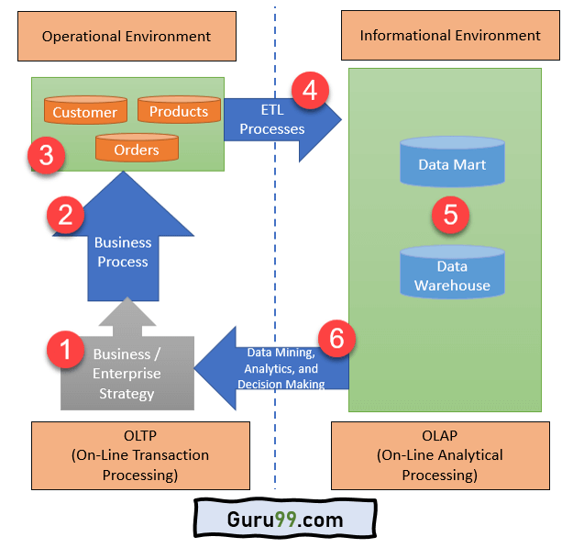

Slide 20
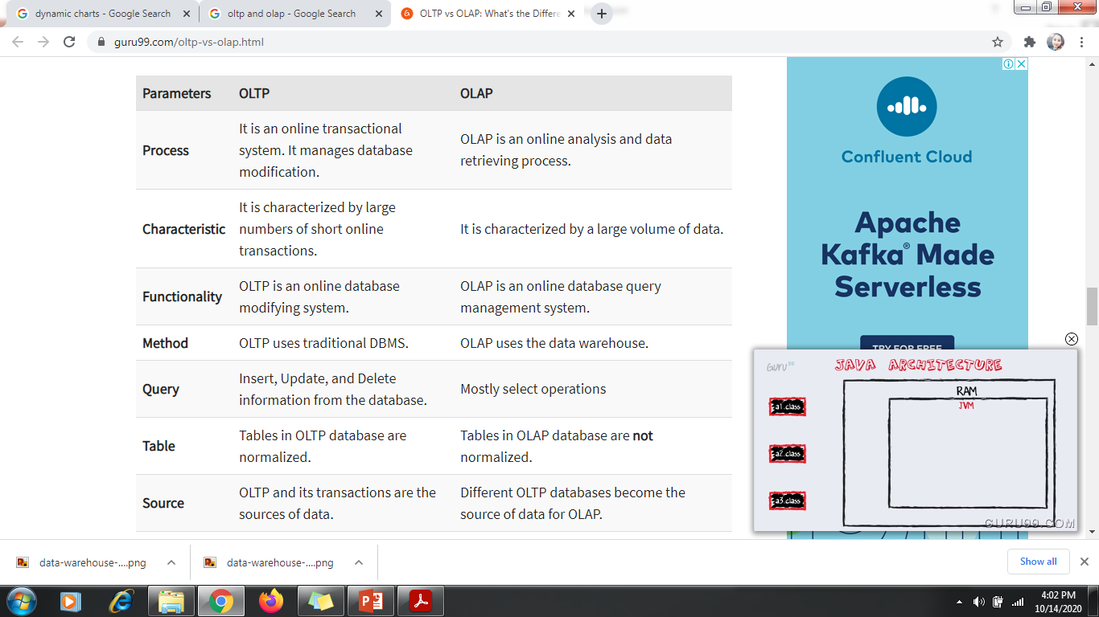
OLTP vs OLAP

Slide 21
OLAP Operations
Since OLAP servers are based on multidimensional view of data, we will discuss OLAP operations in multidimensional data.
Here is the list of OLAP operations −
Roll-up
Drill-down
Slice and dice
Pivot (rotate)

Slide 22
Roll-up
Roll-up performs aggregation on a data cube in any of the following ways −
By climbing up a concept hierarchy for a dimension
By dimension reduction
The following diagram illustrates how roll-up works.

Slide 23
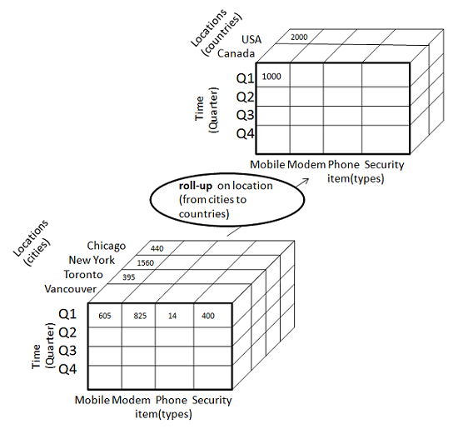

Slide 24
Roll-up is performed by climbing up a concept hierarchy for the dimension location.
Initially the concept hierarchy was "street < city < province < country".
On rolling up, the data is aggregated by ascending the location hierarchy from the level of city to the level of country.
The data is grouped into cities rather than countries.
It navigates the data from high detailed data to low detailed data.
When roll-up is performed, one or more dimensions from the data cube are removed.

Slide 25
Drill-down
Drill-down is the reverse operation of roll-up. It is performed by either of the following ways:
By stepping down a concept hierarchy for a dimension
By introducing a new dimension.
The following diagram illustrates how drill-down works −

Slide 26
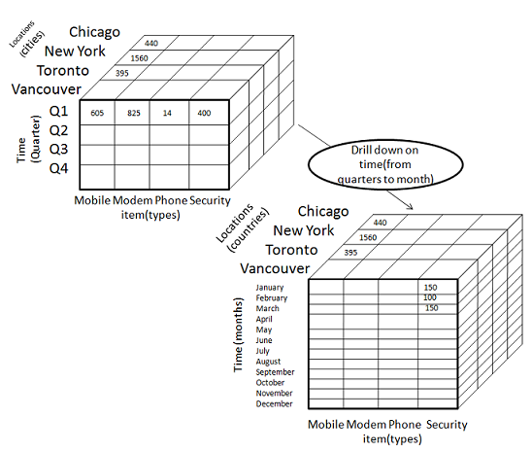

Slide 27
Drill-down is performed by stepping down a concept hierarchy for the dimension time.
Initially the concept hierarchy was "day < month < quarter < year."
On drilling down, the time dimension is descended from the level of quarter to the level of month.
When drill-down is performed, one or more dimensions from the data cube are added.
It navigates the data from less detailed data to highly detailed data.

Slide 28
Slice
The slice operation selects one particular dimension from a given cube and provides a new sub-cube.
Consider the following diagram that shows how slice works.

Slide 29
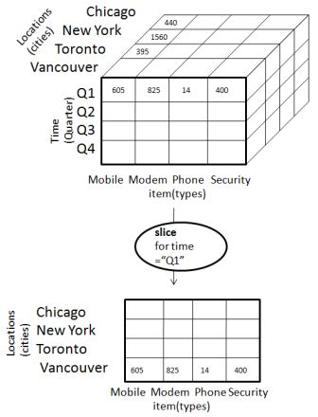
Here Slice is performed for the dimension "time" using the criterion time = "Q1".
It will form a new sub-cube by selecting one or more dimensions.

Slide 30
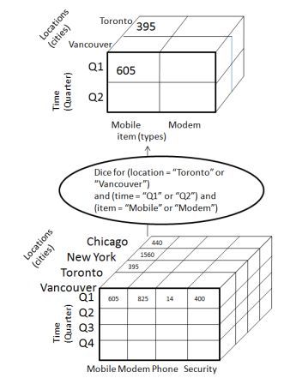
Dice
Dice selects two or more dimensions from a given cube and provides a new sub-cube. Consider the following diagram that shows the dice operation.

Slide 31
The dice operation on the cube based on the following selection criteria involves three dimensions.
(location = "Toronto" or "Vancouver")
(time = "Q1" or "Q2")
(item =" Mobile" or "Modem")

Slide 32
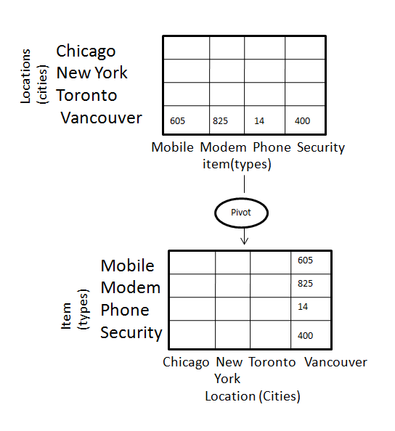
Pivot
The pivot operation is also known as rotation. It rotates the data axes in view in order to provide an alternative presentation of data. Consider the following diagram that shows the pivot operation.

